Slide 1

Instagram User Analytics
Project By: Sneha Pasalkar
Platform used: SQL workbench

Slide 2
Business task
To analyze data of Instagram in various aspects and help different teams plan their upcoming events and strategies accordingly to grow overall business.

Slide 3
Description of project
This role involves analyzing user interactions and engagement with the Instagram app to provide valuable insights that can help the business grow.
This include how users engage with a digital product, such as a software application or a mobile app
It is basically divided into two parts:
Marketing Analysis
Investor Metrics

Slide 4
Approach
Our approach to this project will be mainly divided into two main parts:
Marketing Analysis
Investor Metrics
Marketing analysis
Inactive user engagement
Contest winner declaration
Hashtag research
Ad campaign launch
Loyal user reward
Investor Metrics
User engagement
Bots and fake accounts

Slide 5
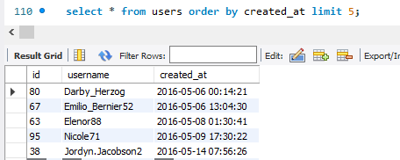
Marketing Analysis
Loyal User Reward
Task 1: Identify the five oldest users on Instagram from the provided database
Approach: We checked that our users table have columns: id, username, created_at respectively, to identify 5 oldest users we sort users table based on created_at column with limit 5

Slide 6
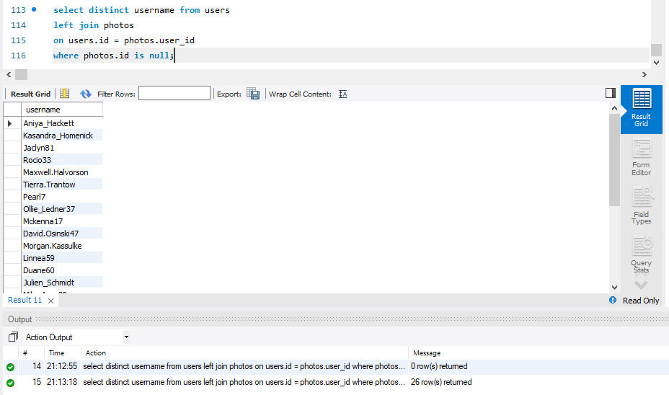
Inactive User Engagement
Task 2: Identify users who have never posted a single photo on Instagram
Approach: to solve this we need to join two tables, users and photos respectively, need to use left join as user will be available in users table but not in photos table
Result: Shows 26 such users who never posted on account.

Slide 7
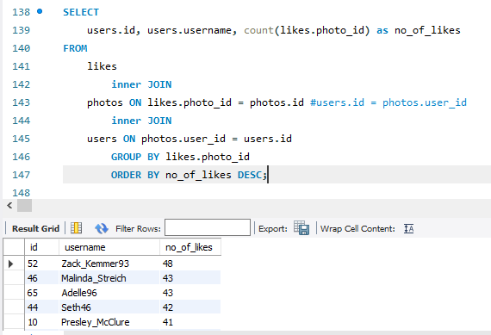
Contest Winner Declaration
Task: Determine the winner of the contest, where the user with the most likes on a single photo wins.
Approach: To solve this we need to deal with 3 tables: users, photos, likes. We are looking for highest number of likes on photos hence we select count of photos_id as number of likes from like table inner join that table with photos table to fetch photo details and inner join photos table with users to get users details. We have displayed user id an user name with number of likes to find highest likes, we have use desc() to help us sort result with highest count first. We have used group by() on photos_id of likes table to achieve this result.
Result: user with id : 52 and username : zack_kemmer93 is winner of contest with 48 likes on single photo

Slide 8
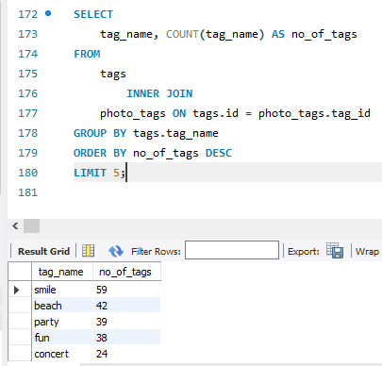
Hashtag Research
Task: Identify and suggest the top five most commonly used hashtags on the platform
Approach: To solve this we need to use 2 tables - first tags which holds details like tag id, tag name and when that tag is created, second is photo_tags which holds photo id and tag id details, this table will gave us tag id’s which are used on different photos. We will use inner join to find tag names mostly used on photos
Result: Top 5 Hashtags are: smile, beach, party, fun, concert

Slide 9
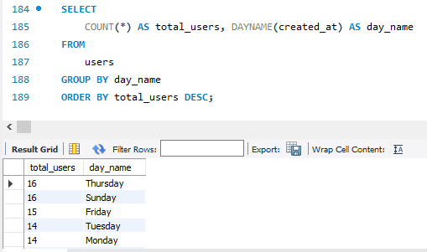
Ad Campaign Launch
Task: Determine the day of the week when most users register on Instagram
Approach: To solve this will use users table, will fetch day from created_at column using dayname(), will count number of users registered from same table and group data by day name and sort data using order by () with user count
Result: We have higher registrations on Thursday and Sunday

Slide 10
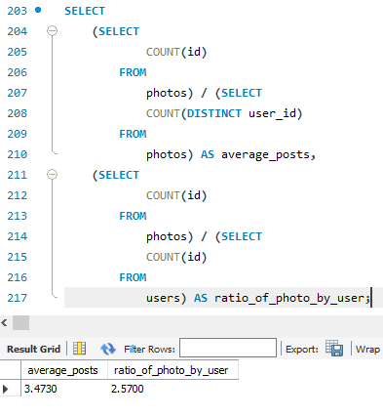
Investor Metrics
User Engagement
Task: Calculate the average number of posts per user on Instagram. Also, provide the total number of photos on Instagram divided by the total number of users
Approach: To solve this we have taken count of photos and divide it by count of users using distinct() to get average post per user and then we have counted number of photos and divided by total users to find ratio
Result: Average post per user is 3.47 and ratio of post to users is 2.57

Slide 11
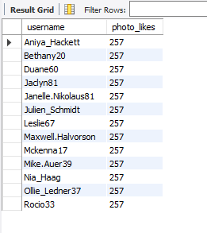
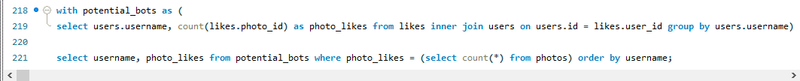
Bots & Fake Accounts
Task: Identify users (potential bots) who have liked every single photo on the site
Approach: first we calculated total number of entry in photos column, we found that it is 257, the we have used CTE to find no of photos a user have liked to identify potential bots.
Result: we have found 13 user names who liked 257 photos that means all photos so these can be potential bots.

Slide 12
Insights
We have identified 5 oldest users, marketing team can plan strategy for them for being loyal users which can motivate other users to stay with platform.
We have found 26 users which are inactive, we can plan activity or push notifications to encourage those user to use the platform.
We have found winner of our contest, we should encourage such contests and engage users to take participations to improve overall user engagement.
We have found top 5 used hashtags of the application. Team should work on recommending these hashtags to users while creating a new post as it will help us improve user experience.
We have identified days when mostly a new user gets registered, our team can plan ad-campaign strategy to make sure we are sending notifications or promotions on or prior to such days so that we can have maximum users registered on our platform.
We have found average number of posts and ratio of customer with number of post, we can use this data to share with stake holders to show potential of our application so that they can trust and invest in our growth.
We have also identified potential bots, this data will help team to remove such potential bots to avoid fraud that might happen and encourage people to have real accounts and information to share which will result in positive user experience.

Slide 13
Thank you!

